Slide 1
Operating Systems
SENS-3513
Week: 14
Memory Management 1
Operating System Concepts
9th edition
Silberschatz, Galvin & Gagne
John Wiley & Sons
2013
Dr Nauman Mazhar
Faculty of Information Technology (FIT)
University of Central Punjab (UCP)

Slide 2
Agenda
Basic concepts
Address Translation
Swapping
Contiguous Memory Allocation
  MFT
  MVT
  Fragmentation (Internal & External)
Non-Contiguous Memory Allocation
  Paging
    hardware Support
    memory Allocation
    address Translation
    protection
2

Slide 3
Purpose of Memory Management
“To ensure fair, secure, orderly, and efficient
use of memory”
Objectives:
When, where, and how much memory to allocate, and deallocate
Keep track of used & free memory space
Swap processes in & out of main memory
3

Slide 4
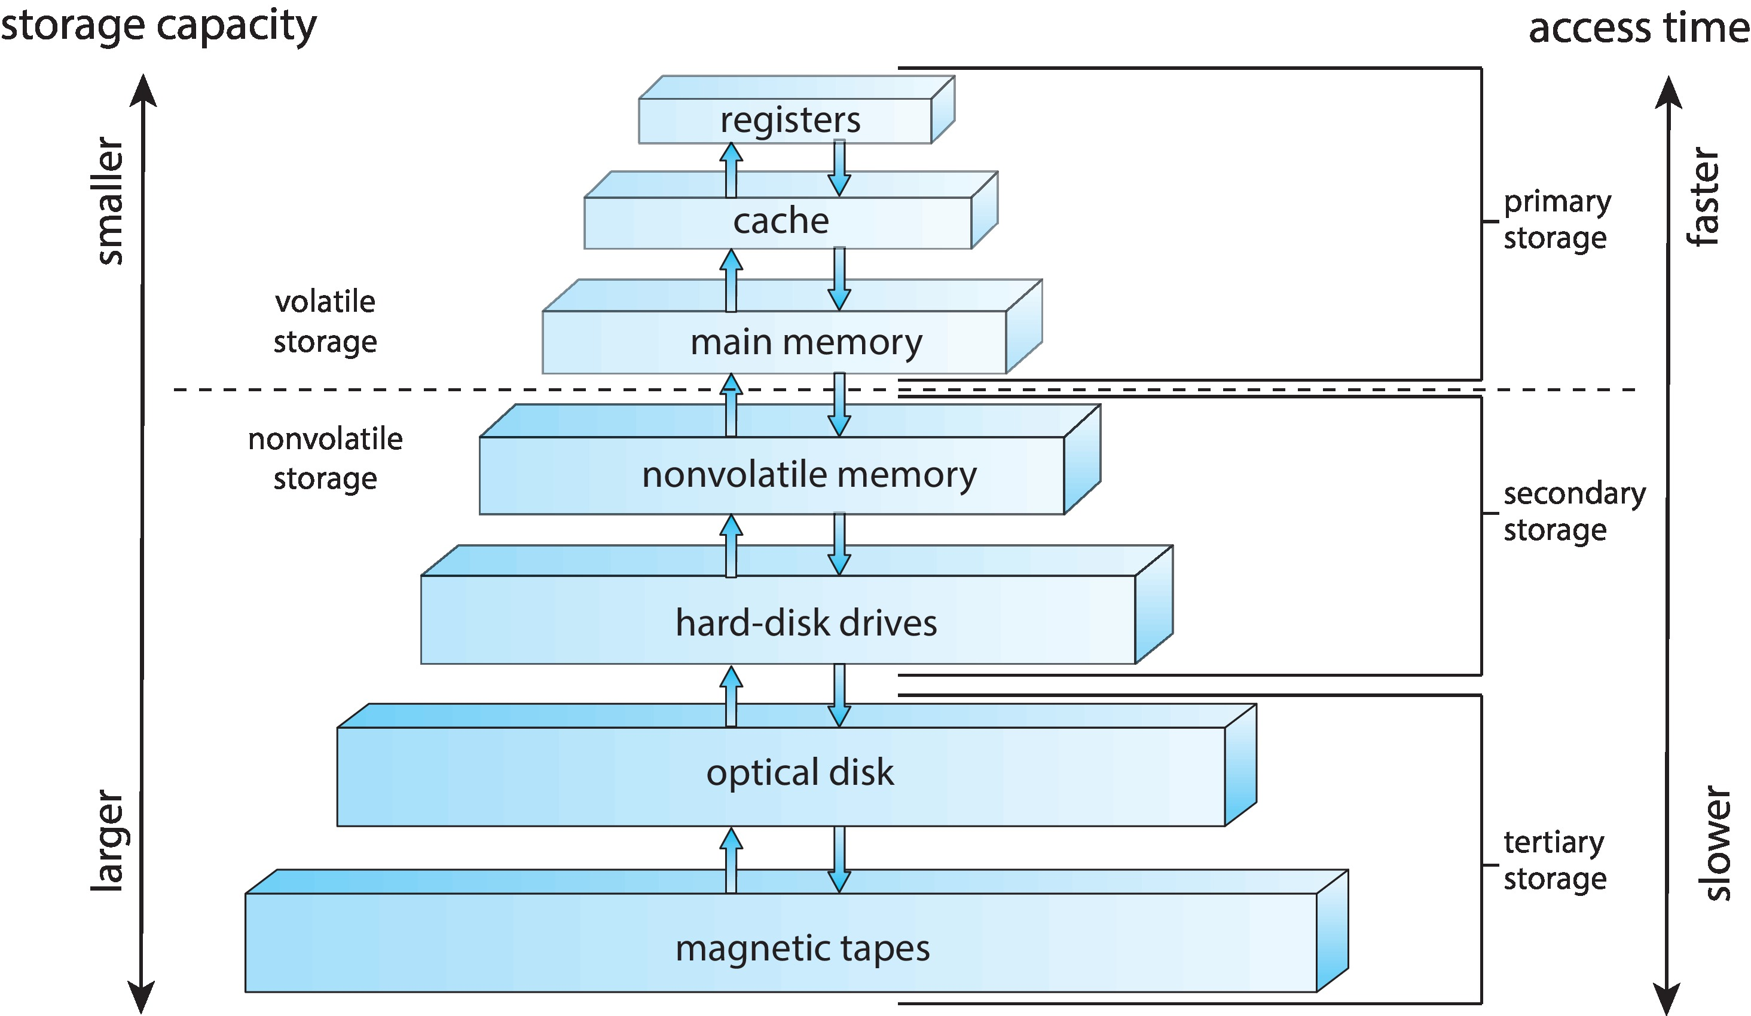
Memory Hierarchy
CPU registers – very small, extremely fast, very expensive, & volatile
Cache – small, very fast, expensive, & volatile
Main memory – GBs of medium-speed, medium-price, & volatile
Secondary storage – hundreds of GBs of slow, cheap, & non-volatile
4

Slide 5
Background
For execution, program is to be brought from disk to memory,
& placed within its address space
  CPU then accesses program instructions & data
CPU can directly access only main memory, cache & registers
  Register – access in one CPU clock cycle (or less)
  Main memory – can take many CPU cycles
  Cache – sits between main memory & CPU registers
As program executes, a stream of addresses is generated to read and write to/from memory
  all memory references pass thru Memory Management Unit
5

Slide 6
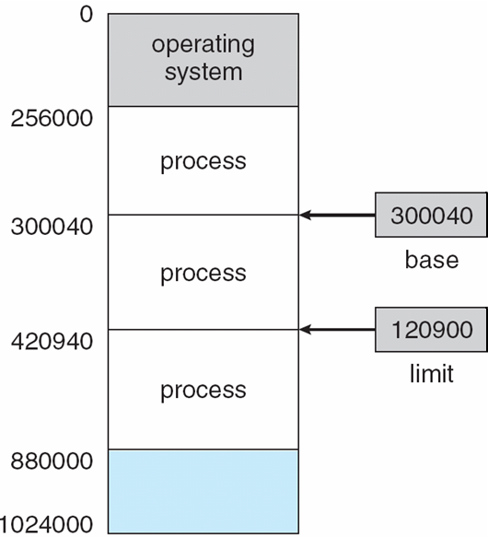
Memory Protection
Memory needs protection
Base & Limit registers provide hardware based memory protection
  define physical address space of
  process
  Base: starting address of
  process memory partition
  Limit: size of process address
  range in memory
  these registers can only be
  loaded by OS
6

Slide 7
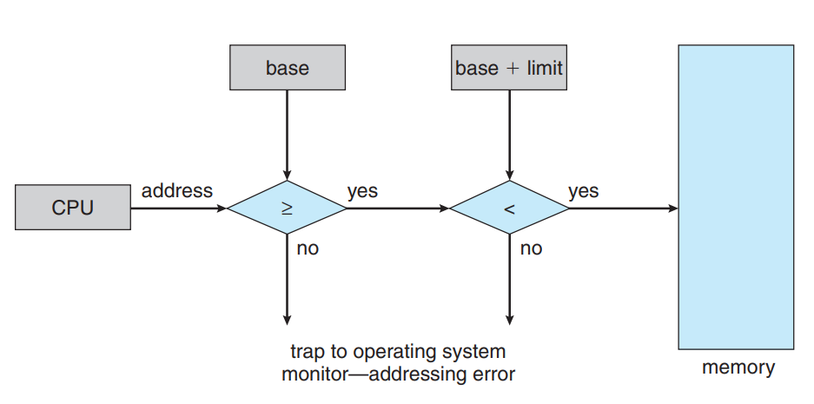
Memory Protection
CPU checks every memory access generated in User mode
  ensures it lies between base & limit for that user
  prevents a process from modifying code/data of OS or some other process
7

Slide 8
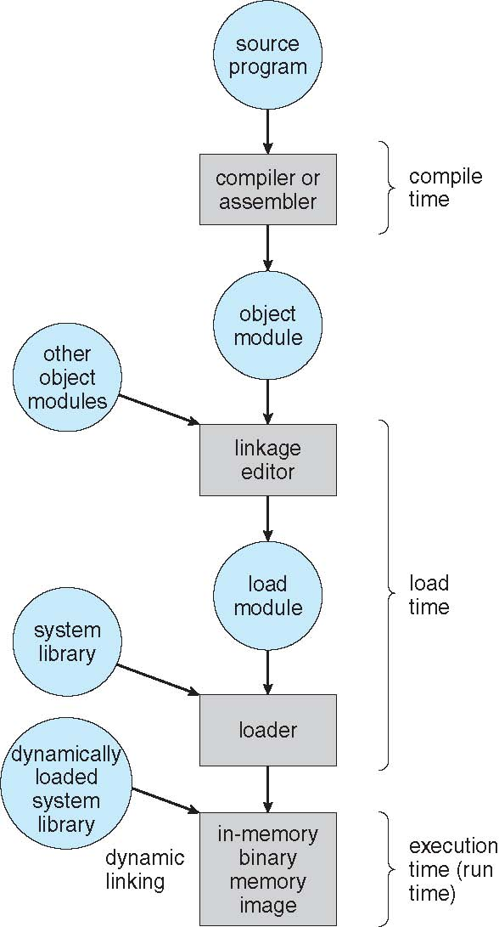
Program Lifetime
User program goes thru different stages during its lifetime
(shown in figure)
8

Slide 9
Address Binding
Different types of addresses used at different stages in program life
  Symbolic address : address in source code is usually symbolic
    such as, variable “count”
  Relocatable address : address that is relative to some base address
    14 bytes from beginning of this module
    compiler generates object files with relocatable addresses
  Absolute address : linker / loader combine object files & resolve relocatable addresses to absolute addresses
    refer to final location in final executable, e.g ‘0x00401000’
    in modern systems, absolute address refers to logical address, in logical address space of a process
“Address binding is the mapping of
one address space to another”
9

Slide 10
Address Binding
Binding of instructions & data to memory addresses
can be done at any of the following stages
Compile time : if memory location known a priori, absolute code can be generated at compile time
    must recompile code if starting location changes
Load time : if memory location not known at compile time, relocatable code is generated – binding done at load time
Execution time : if during execution, process can be moved from one memory segment to another, address binding delayed till run time
    need hardware support for run time address mapping
    (e.g, relocation register)
10

Slide 11
Static & Dynamic Linking
System libraries need to be linked with user programs
Static linking
  necessary library code included in executable at compile time
  generates complete binary image of program – library code is made part of executable
Dynamic linking
  linking done at load time or runtime
  library code not included in executable – instead, references to shared libraries are included
  necessary code is linked when program starts or when code is first needed
  if library code not in memory, it is loaded at this time
11

Slide 12
Static & Dynamic Linking
Advantages of Dynamic Linking
  less disk space needed to store binaries
  less memory space needed by process
  less time needed to load a program
  allows shared usage of libraries
Disadvantages of Dynamic Linking
  time consuming run time activity
  results in slower program execution
gcc compiler uses dynamic linking by default
    use –static option to force static linking
12

Slide 13
Logical & Physical Address
Logical address
  address generated by CPU during program execution
  address where data/code appear to reside, from the perspective of an executing program
Physical address
  address generated by MMU
  refers to an actual location in physical memory (RAM)
  Logical Address ≠ actual Physical RAM Address
When process tries to access a Logical address, system translates it to Physical address
  Logical to Physical address mapping
13

Slide 14
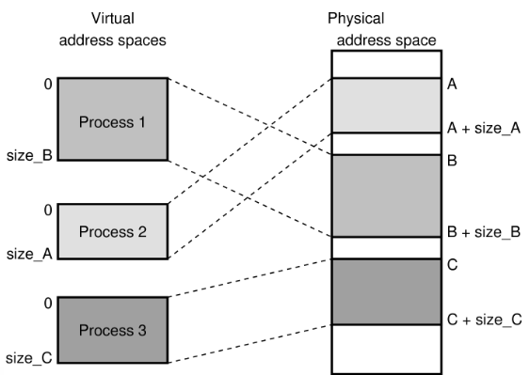
Logical & Physical Address

Slide 15
Memory Management Unit
MMU – hardware device for run time address mapping
“map logical to physical address at run time”
Generalization of Base register – Relocation Register
value in relocation register, added to every address
generated by user process, at the time it is sent to memory
User programs deal with logical addresses, and never see real physical addresses
  when reference is made to some location in memory
  binding is done at run time
15

Slide 16
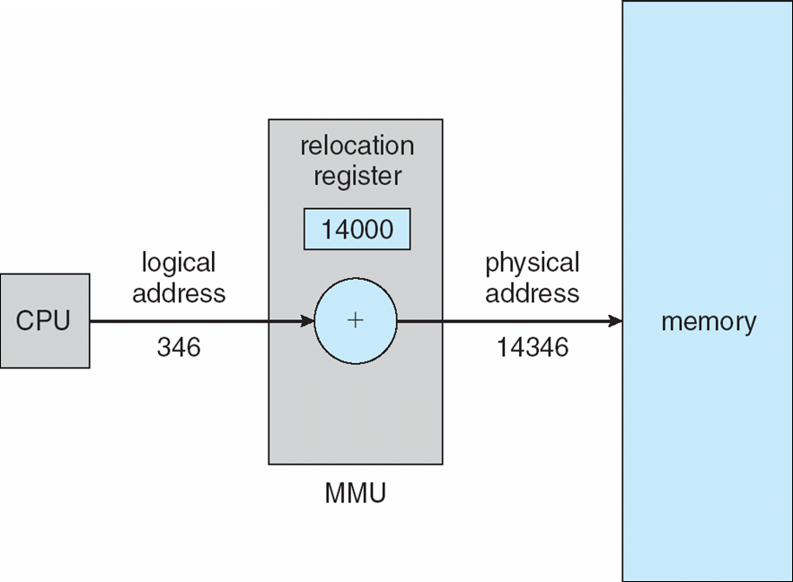
Use of Relocation Register
Example: consider that base is at memory address 14000
an attempt to access memory location 0
is dynamically relocated to location 14000
an access to location 346 is
mapped to location 14346
16

Slide 17
Swapping
A process can be swapped out of memory to a backing store
  then brought back into memory for continued execution
  “total physical memory space of processes can exceed
  total physical memory available”
Backing store – disk large enough to accommodate copies of memory images for all users
Major part of swap time is the transfer time
  transfer time directly proportional to amount of memory swapped
Problem: Consider a process of size 10 MB. Disk to memory transfer rate is 5 MB per sec. Avg disk latency is 8 msec (no seek time). Calculate total cost of swapping. (for swap out + swap in)
17

Slide 18
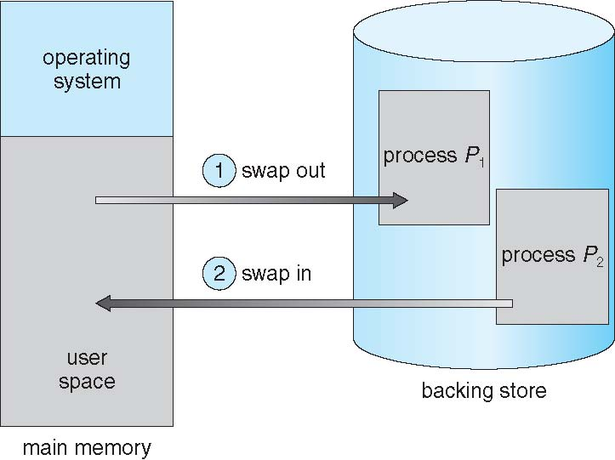
Schematic View of Swapping
18

Slide 19
  Contiguous Memory Space
  Allocation
19

Slide 20
Contiguous Allocation
Main memory must support both OS & User processes
  limited resource
  must be allocated efficiently
Contiguous Allocation – one early method
  when brought into memory, entire process comes in
  process loaded at one place in memory
  “process is placed in a single contiguous area in memory”
Base (re-location) & Limit registers are used to map Logical to Physical address
  base → contains smallest memory address of process
  limit → contains its size
20

Slide 21
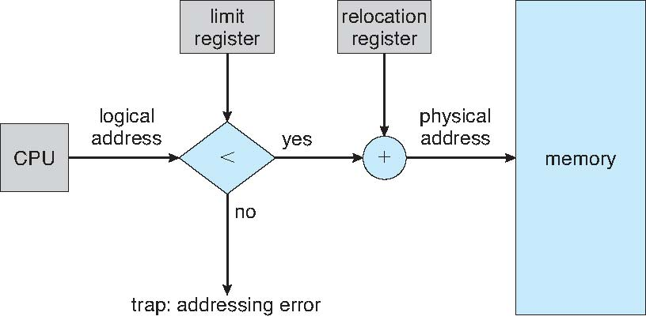
Hardware Support – Relocation & Limit Register
21

Slide 22
Contiguous Allocation
Two techniques for contiguous memory space allocation used in earlier OS:
  MFT – Multiprogramming with Fixed Tasks
    multiple fixed size partitions
  MVT – Multiprogramming with Variable Tasks
    multiple variable size partitions
22

Slide 23
M F T – Fixed Partitioning
Multi programming with Fixed Tasks
Memory divided into several fixed size partitions
  each partition may be of same or different size
  each partition contains exactly one process / task
When a partition is free
  another process selected from input queue, & loaded
When process terminates
  partition becomes available again, for allocation
23

Slide 24
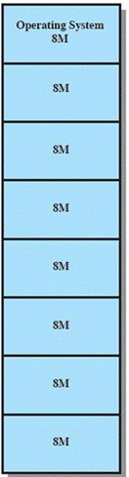
M F T
Equal size partitions
OS can load a process whose size is less than or equal to an available partition
  can also swap out a process from the partition,
  if not in Running state
Program may not fit in a partition…
  use Overlaying
  “bring in program instructions & data as needed,
  and always load into same space”
Memory usage is inefficient
  even a small program occupies entire partition
  results in – Internal Fragmentation
24

Slide 25
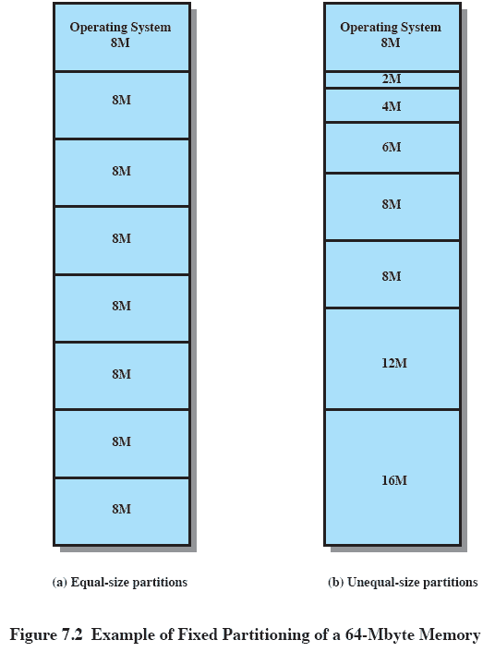
M F T
Un-Equal size partitions
Partitions sizes are fixed, but different
Programs up to 16 M accommodated without overlay
Smaller programs placed in smaller partitions
  reduces Internal Fragmentation
Lessens the problem with fixed, same size partitions
  but doesn’t solve completely
25

Slide 26
MVT – Dynamic Partitioning
Multi programming with Variable Tasks
Partitions created dynamically at run time
  each process loaded into a partition of exactly the same size
  as that of process
  both number & size of partitions change with time
Process can move form one partition to another
  after swapping out, a process can be swapped back in some other partition
No internal fragmentation
  but causes External Fragmentation
26

Slide 27
M V T
Limitation:
Technique leads to situation where a lot of small empty spaces are created in memory
External Fragmentation
“when total amount of unused memory available in the system
is enough to satisfy a request,
but empty spaces are not contiguous”
Solution – Compaction
  from time to time, OS shifts all processes to combine empty spaces into one big free space
  time consuming – wastes CPU cycles
  possible only if address binding done at run time
27

Slide 28
M V T
Placement Algorithms
At load / swap in time, if more than one free memory block of sufficient size is available, OS must decide which block to allocate
First Fit
  allocate the first available free space that is large enough
Best Fit
  scan all free blocks, & choose the one with nearest size
  need to search entire list
  produces least unused free spaces
Worst Fit
  allocate the largest available partition
  can prevent small partitions from being fragmented
28

Slide 29
Sample Problem
Problem
  Show how the available memory of 810 KB will be allocated using MVT approach, when job sequence is as given below; use all three placement algorithms.
  Job Sequence:
    J1 (90K), J2 (45K), J3 (180K), J4 (90K), J5 (135K), J6 (180K)
    J3 terminates, J5 terminates
    J7 (135K), J8 (180K)
    J7 terminates, J8 terminates
    J9 (285K)
29
Notes:
Discuss the solution

Slide 30
  Non-Contiguous
  Memory Space Allocation:
  Paging
30

Slide 31
Introduction to Paging
Paging
  “memory management scheme for non-contiguous
  allocation of memory space”
  efficient sharing of physical memory among processes
  allows a program to run as if it has a contiguous block of memory, even if its physical memory is fragmented
Logical / Virtual address space
  set of addresses referenced by a program during its execution,
  when it tries to access instructions & data
Physical address space
  set of addresses used by system to access actual physical locations
  in memory
31

Slide 32
Introduction to Paging
Paging is managed by Memory Management Unit (MMU)
  hardware component that translates virtual address space of a process to its physical address space
To implement paging…
  Logical address space is divided into Pages
  Physical address space is divided into Frames
Pages and Frames must be of same size
  typical page size – 1KB to 64 KB
  (different for various architectures)
32

Slide 33
Introduction to Paging
Program is loaded by loading its pages into available frames
  pages loaded from disk are said to be mapped into main memory
To run a program having n pages
  find n free frames, and load the pages into these frames
  frames need not be contiguous
We also need to store this mapping info in a data structure, called as “Page Table”
  “record of which page is loaded in which frame”
External fragmentation – is avoided
Internal fragmentation – half a page per process (on average)
33

Slide 34
Page Tables
Page Table – keeps track of logical to physical address mapping
Page table is indexed by page numbers
  page table entry holds the frame number,
  where page is loaded
PTE may also have…
modify bit, resident bit, valid bit, protection bit
Page table size…
  depends on max number of pages in process
  if process has 8 pages
    number of rows in page table – 8 rows
    bits to represent 8 page numbers – 3 bits
Frame No
000
001
010
011
100
101
110
111
34

Slide 35

Use of Page Tables
Page # of a process
Frame # of physical
memory where this
page is loaded
35

Slide 36
Logical Address Format
Logical Address: format (p, d)
Address generated by CPU has two parts:
  Page number (p)
  used as index into page table
  is the row number in table, which
  contains base address of its frame
  Page offset (d)
  displacement within the page
  combined with base address of frame defines physical memory address
  that is to be accessed
  logical address space 2^{m} page size 2^{n}
  number of pages 2^{m-n}
page number
page offset
p
d
m - n bits
n bits
Logical address (2,6) → page number = 2, displacement = 6
36

Slide 37
Physical Address Format
Physical Address: format (f, d)
Physical address is obtained from L.A, & comprises:
  Frame number (f)
  kept in page table against the page
  number
  gives the address of frame in memory
  Frame offset (d)
  displacement within the frame
  same as page offset
  physical address space 2^{k} frame size 2^{n}
  number of frames 2^{k-n}
frame number
page offset
f
d
k - n bits
n bits
Physical address (3,6) → frame number = 3, displacement = 6
37

Slide 38
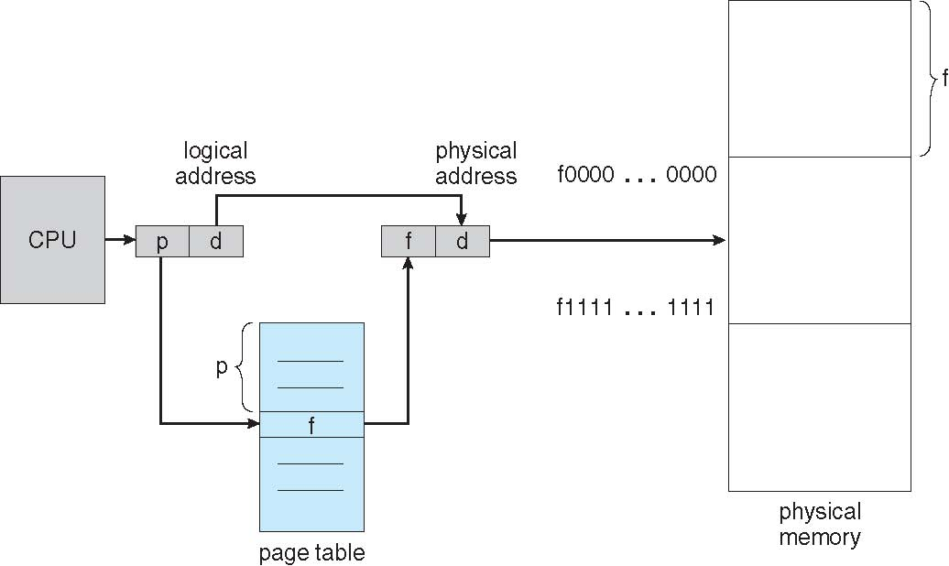
Address Translation in Paging
Index into page table
Displacement within
the page
38

Slide 39
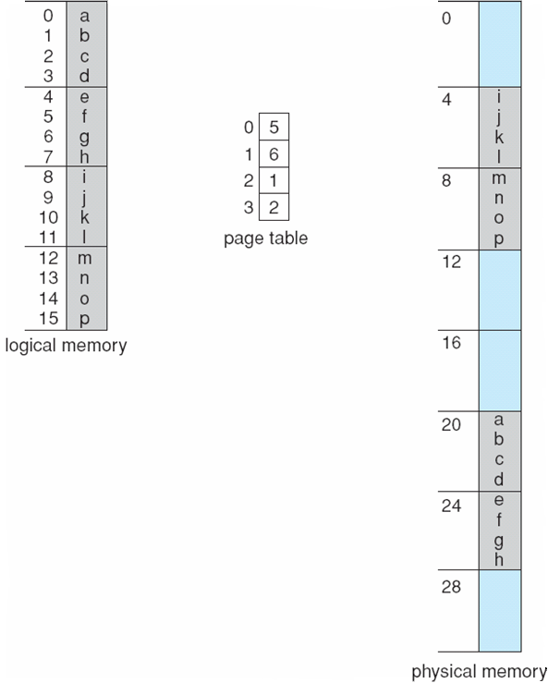
Paging Example
Logical address space = 16 bytes
(bits needed, m = 4)
Page size = 4 bytes
(bits needed for d: n = 2)
No. of pages = 4
(bits needed for p: m-n = 2)
Physical address space = 32 bytes
(bits needed k = 5)
No. of frames = 8
(bits needed for f: k-n = 3)
Page#
Frame#
0111
11011
Map the data value h from logical to physical memory:
Logical address (p, d) : (1,3) = 0111
Physical address (f, d) : (6,3) = 11011
39

Slide 40
Page Table Entry
Typical PTE format…
1
1
1
2
20
M
R
V
pro
t
pa
ge
f
rame
nu
mbe
r
Various bits used by MMU on each page access:
  Modify/Dirty bit: indicates whether page is modified since loaded
  Resident bit: indicates whether page is resident in memory or not (may be on disk)
    not an error for a program to access a non-resident page
    page fault occurs, & page is brought into memory from disk
  Valid bit: page is legal for program to access (part of address space)
  Protection bits: specify page access rights (read/ write/ execute)
40

Slide 41
Paging - Sample Problems
Problem 1
Let 14000 be a logical address, in decimal. If page size is 1 KB, in which page does this address exist; also find its offset from the start of page. (need to find the values for p & d)
Problem 2
For each of the following logical addresses (in decimal), compute the page number and offset within the page, if the page size is 4 KB.
(a) 20000 (b) 32768 (c) 60000
Repeat for an 8 KB page
Problem 3
Consider a virtual address 40808. Compute the virtual page number and offset for a 4 KB page.
41
Notes:
Problem 21
No of pages = 2^32/2^13 = 2^19 pages
No of entries in PT = 2^19
Time to load one entry = 100 ns = 100 * 10^-9 = 10^-7 sec
Time to load 2^19 entries = 10^-7 * 2^19 = .0524 sec = 52.4 msec
Therefore if a process is given 100 ms slice to execute, 52% of the time slice is spent in loading the page table

Slide 42
Paging - Sample Problems
Problem 4
A machine has a 48 bit virtual addresses and 32 bit physical addresses. Page size is 8 KB. Compute the number of pages and frames.
Problem 5
A system has 48 bit L.A and main memory of 64 GB. The page size is 4096 bytes. Compute the number of pages and frames that exist in the system.
Also give the format of L.A and P.A, along with the number of bits needed to represent p, d & f.
Problem 6
A system has 34 bit logical address, 32 bit physical address, and 16 KB page size. How many entries will be there in the page table. Also compute the page table entry size.
42
Notes:
Problem 21
No of pages = 2^32/2^13 = 2^19 pages
No of entries in PT = 2^19
Time to load one entry = 100 ns = 100 * 10^-9 = 10^-7 sec
Time to load 2^19 entries = 10^-7 * 2^19 = .0524 sec = 52.4 msec
Therefore if a process is given 100 ms slice to execute, 52% of the time slice is spent in loading the page table

Slide 43
Paging - Sample Problems
Problem 7
Consider a logical address space of 16 pages, each of 1024 words, mapped into a physical memory of 32 frames. Give the Logical and Physical address format. Also give the total Logical and Physical address space. Compute the required page table size for this situation.
Problem 8
A machine has 32 bit logical address space and 8 KB page. Page table is entirely in hardware, with one 32 bit word per entry. When a process starts, page table is copied to the hardware from memory, at one word every 100 nsec. If each process runs for 100 msec (including the time to load the page table), what fraction of CPU time is devoted to loading the page tables.
43
Notes:
Problem 21
No of pages = 2^32/2^13 = 2^19 pages
No of entries in PT = 2^19
Time to load one entry = 100 ns = 100 * 10^-9 = 10^-7 sec
Time to load 2^19 entries = 10^-7 * 2^19 = .0524 sec = 52.4 msec
Therefore if a process is given 100 ms slice to execute, 52% of the time slice is spent in loading the page table

Slide 44
  Implementation of
  Page Table
44

Slide 45
Implementation of Page Table
Page Table implementation options
  Page Table in CPU Registers
  Page Table in Main Memory
  Page Table in Associative Cache / TLB
  (Translation Look Aside Buffer)
45

Slide 46
Implementation of Page Table
Page Table in CPU Registers:
Design CPU in such a way that page table can be kept within the CPU, using CPU registers (costly affair)
Feasible for process with small logical address space with less number of pages, which may be of large size
Effective Memory Access Time is almost the same as Physical memory access time
(includes time to convert L.A to P.A, and then access physical memory)
Example : PDP-11, which has eight pages each of size 8 KB
46

Slide 47
Implementation of Page Table
Page Table in Main Memory:
Page table is kept in main memory
  PTBR – page table base register points to starting address of page table
  PTLR – page table length register indicates size of page table
In this scheme, every data/instruction access requires two memory accesses
  one for page table, that resides inside the main memory
  second for accessing data / instructions in memory
  T_{EFFECTIVE} = 2 T_{MEM}
47

Slide 48
Implementation of Page Table
Page Table in Associative Cache / TLB:
Associative Cache, or Translation Look Aside Buffer (TLB), stores recently translated virtual-to-physical address mappings
Complete page table resides in main memory
  but TLB contains subset of most recently used PTEs for currently running process
  reduces address translation time, for faster memory access
If mapping found in TLB → page hit; else → page fault
  probability of Hit or Miss
Upon context switch…
  TLB is flushed, & loaded with values for newly scheduled process
48

Slide 49

Paging Hardware With TLB

Slide 50
Implementation of Page Table
Paging performance using TLB:
Page Access Time → Page Hit
= Time to access TLB + Time to access memory
= T_{TLB} + T_{MEM}
Page Access Time → Page Fault
= Time to access TLB + 2 x Time to access memory
= T_{TLB} + 2 T_{MEM}
Effective Memory Access Time
  If HR is hit ratio, and MR is miss ratio, then:
  T_{EFFECTIVE} = HR (T_{TLB} + T_{MEM} ) + MR ( T_{TLB} + 2 T_{MEM} )
50

Slide 51
Implementation of Page Table
Problem 1
Consider a system with 80% hit ratio, 50 nsec time to search CPU registers, 750 nsec time to access main memory.
  Find the time to access a page…
    when page number is found in CPU registers
    when page number is not found in CPU registers
  Also find the Effective memory access time
Problem 2
If hit ratio to TLB is 80%, and it takes 15 nanoseconds to search TLB,
and 150 nanoseconds to access main memory.
  What is the Effective memory access time in nanoseconds
51

Slide 52
Implementation of Page Table
Problem 3
Consider a system with memory access time of 100 nsec. Page table is implemented using associative memory, and TLB access time is 20 ns.
  If Hit ratio is 80%, calculate the Effective memory access time
  Also calculate Effective memory access time if there is no TLB,
  i.e. entire page table is kept in main memory
52
Notes:
Problem 28
Consider a paging system with the page table stored in memory.
If a memory reference takes 200 nanoseconds, how long does a paged memory reference take?
If we add associative registers, and 75 percent of all page-table references are found in the associative registers, what is the effective memory reference time? (Assume that finding a page-table entry in the associative registers takes zero time, if the entry is there.)

